Slide 1
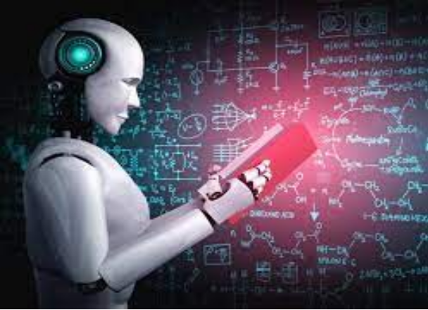
Unit 7.2 - Artificial Intelligence
Prepared by: Koh Kian Hua

Slide 2
Objectives
After completing this unit, students should be able to:
Show understanding of Artificial Intelligence (AI)
Understand the impact of AI including social, economic and environmental issues.
Understand the applications of AI

Slide 3
Artificial Intelligence
Definition of AI
Artificial Intelligence (AI): refers to the simulation of human intelligence in machines that are programmed to think like humans and mimic (imitate) their actions.
Some of these tasks includes:
  Learning and the use of a language
  carrying out a mathematical calculation or function
  recognising a person’s face
  the ability to operate machinery, such as a car, an aeroplane or a train
  analysing data to predict the outcome of a future event, such as weather forecasting.

Slide 4
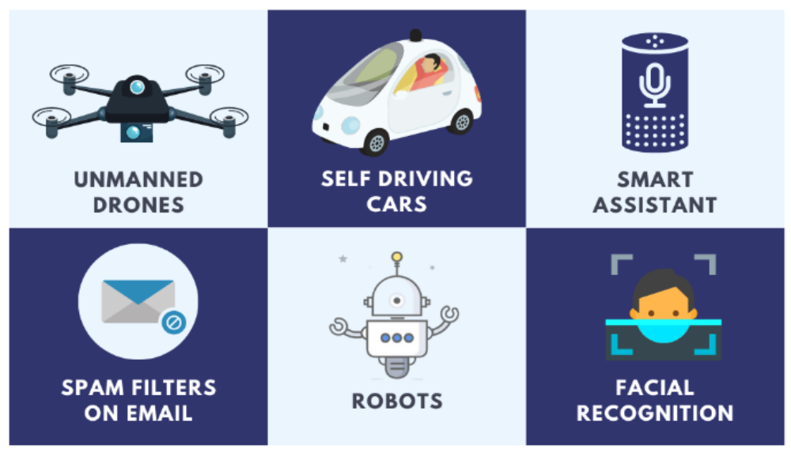
Artificial Intelligence
Examples of AI

Slide 5
Artificial Intelligence
Impact of AI on Society and Economy
Due to increasing automation over the next few decades, we will need to consider the impacts that AI will have on society, the economy and the environment.
With the rise of artificial intelligence;
  Many jobs that are routine routine, will get automated.
  The more jobs that get automated, the more people will have to leave their jobs.
  By 2030, 600 million jobs will be lost globally and 400 million people will need to retrain or switch jobs becauses of the advances in AI.
  Most likely jobs to be lost are those doing medium- and low-skilled work.
  High-skilled jobs (such as hospital technicians, architects, engineers) are also at risk.
  May lead to civil unrest if many young people are out of work.
  However, AI may also lead to a net increase in specific jobs that automation cannot do (eg: quality control, test driving new vehicles)

Slide 6
Artificial Intelligence
Impact of AI on the Environment
AI can help scientists make informed predictions about the environment and potential climate change.
Since, this analysis is quite complex, AI can help in the following ways:
  Conserve natural resources (for example, improve the conservation of water supplies).
  Detection of pollution in the air and seas and allowing scientists to pin-point the source of pollutions more accurately.
  Combine weather forecasting and AI for better predictions about renewable energy resources, using solar, tide, thermal and wind energy.
  Monitoring and modelling a river's ecosystem to allow scientist to gain a better understanding of what can affect the delicate balance of life in the river.

Slide 7
Artificial Intelligence
Impact of AI on Society and Economy
AI can have a big impact on 3 main areas:
Transport: autonomous or driveless cars that can pick up customers at a specific pick-up point and time
Criminal Justice System: Facial recognition systems and in automating legal work.
  Can AI be used to listen in to our mobile phone conversations and assess our emails?
  Any mechanism to challenge an AI inspired legal decision?
  How to ensure no bias in AI decision making process
Advertising and use of data: AI can deliver an ad experience that is more personalized for each user, shapes the customer journey, influences purchasing decisions, and builds brand loyalty.

Slide 8
Artificial Intelligence
Impact of AI on Society and Economy
Despite the benefits that AI brings to our society, it also has some disadvantages. These are :
  High Cost: Creating a machine that can simulate human intelligence is no small feat. It requires plenty of time and resources and can be quite costly (expensive).
  Unemployment: AI is displacing occupations and increasing unemployment. Unemployment can occur as a result of chatbots and robots replacing humans.
  Make Humans Lazy: AI are a used to automate majority of tedious and repetitive task, and this makes humans use their brain less they become lazy. This pose a problem to future generations.
  No Ethics: Ethics and morality are important human features that can be difficult to incorporate into an AI. There is concerns that AI will grow uncontrollably, and eventually wipe out humanity.

Slide 9
Artificial Intelligence
Class Activity
1. Give three different examples of AI.
2. State two benefits and two drawback of using AI.

